Slide 1
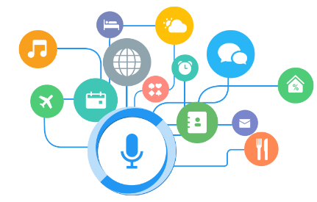
VOICE BASED VIRTUAL ASSISTANT FOR WINDOWS
ABINAYA.S - 224003
KALPANA.S – 224027
DEPARTMENT OF IT

Slide 2
VIRTUAL PERSONAL ASSISSTANT
Voice controlled Personal Digital Assisstants
The combination of
Automatic Speech Recognition
Artificial Intelligence
Natural Language Processing
Inter Process Communication

Slide 3
FEATURES
Speaks Naturally
Communicate with surroundings and other objects
Geofencing and Event based services
Grows with you
Get smarter everyday

Slide 4
WORKING
Any Virtual Assisstant basically consists of
three layers
Speech to text
Text Analysing
Interpret commands

Slide 5
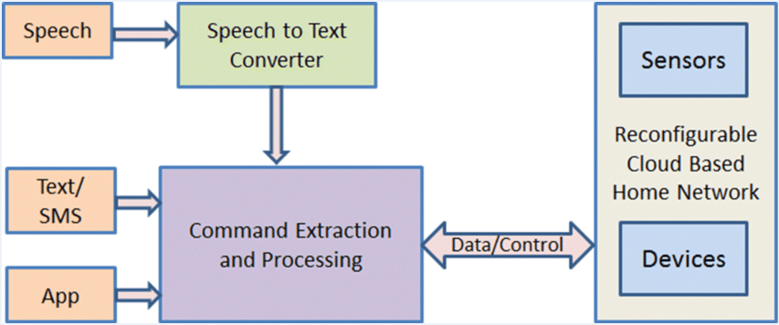

Slide 6
ADVANTAGES
Make small and smart hand-held devices to combne multiple features
Allows to export and import data
Reminds important things on accurate situations
Controls various application of device
Store various information

Slide 7
Effective way to organize your schedule
Performing well than PDA devices
Reliable than Human Personal Assistant
Portable
Have lot of information as they are connected with internet

